Slide 1
Ezekiel 33-35
"So when it comes to pass--as surely it will--then they will know that a prophet has been in their midst." (Ezekiel 33:33)

Slide 2
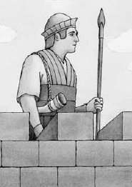
Ezekiel 33: The Watchman
The Mission and Message of the Watchman (33:1-20)
The “watchman principle” (1-9)
Similar to Ezekiel 3:16-21, but with a difference…
Purpose is found in Ezekiel 33:10-11
Notice the emphasis on turning, restoring and practicing righteousness… (12-20)
Many said “the way of the Lord is not right” (17, 20)

Slide 3
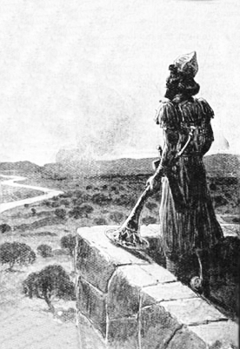
Ezekiel 33: The Watchman
The Ministry of the Watchman (33:21-33)
The refugees message: Jerusalem has fallen! (21-22)
Ezekiel now ministering to two groups:
Survivors in Palestine (23-29)
Captives in Babylon (30-33)
Attitudes toward Ezekiel have changed (30)
Yet actions still lacking… (31-32)

Slide 4
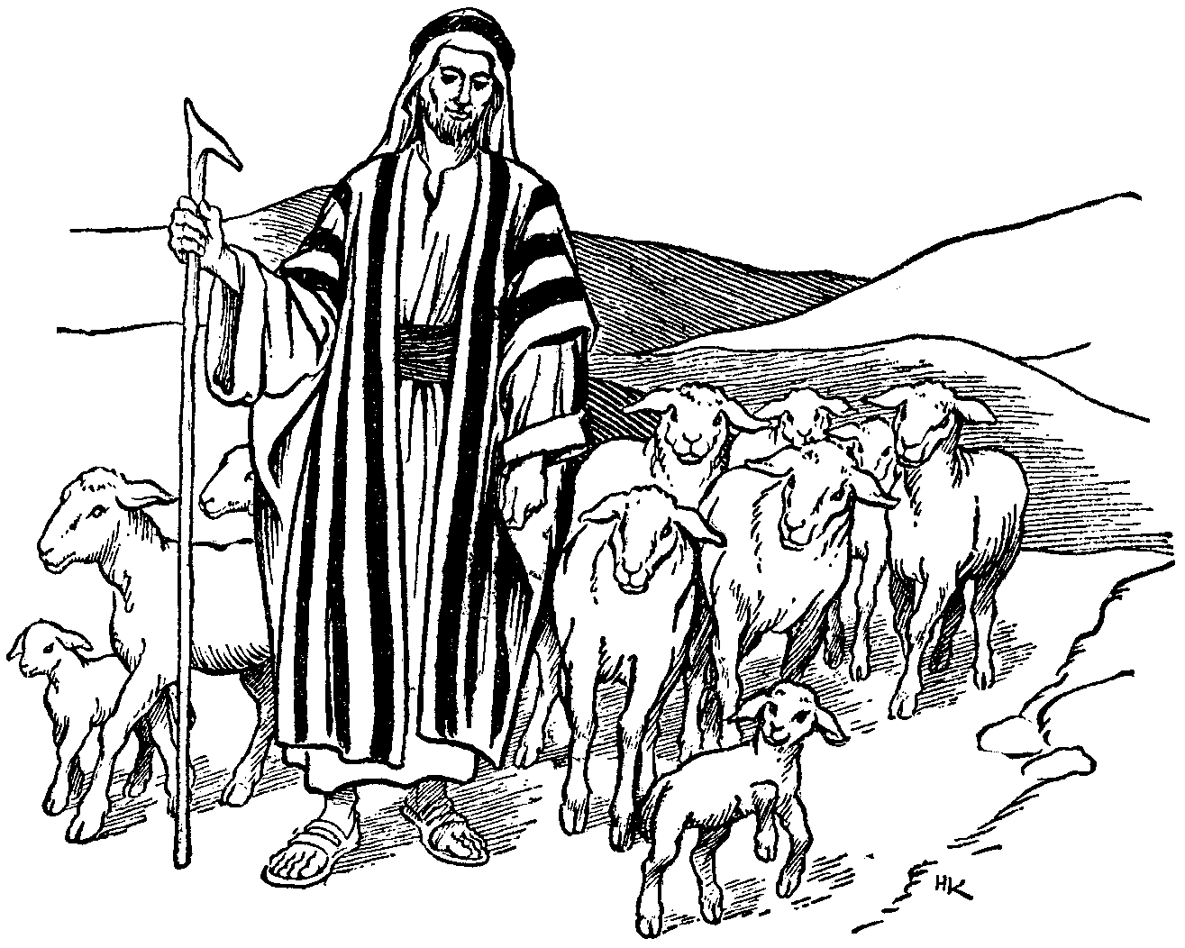
Ezekiel 34: The Shepherds
The Evil Shepherds (34:1-10)
The Divine Shepherd (34:11-22)
The Future Shepherd (34:23-31)

Slide 5
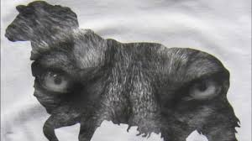
Ezekiel 34: The Shepherds
Evil Shepherds (34:1-10)
Woe to the leaders of Israel!
Four Crimes (1-8)
Used flock of God for their own gain.
Had no concern for the flock of God.
Ruled with force and severity.
Responsible for scattering the flock.
Therefore… God is against them (9-10)

Slide 6
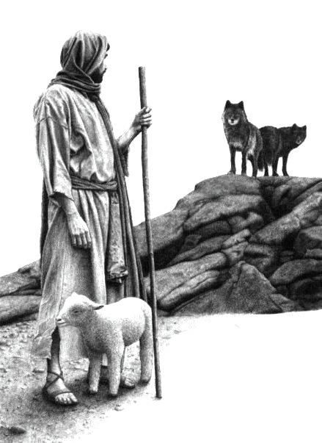
Ezekiel 34: The Shepherds
The Divine Shepherd (34:11-22)
During exile God Himself would be their shepherd.
As Shepherd, he would:
Seek out His sheep.
Deliver them from where they were scattered.
Bring them out from among the peoples.
Restore them to their fold (land).
Feed them upon the mountains.
Lead His flock to rest/safety.
He would judge between the good and bad sheep.

Slide 7
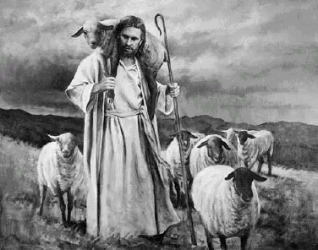
Ezekiel 34: The Shepherds
The Future Shepherd (34:23-31)
After the restoration God would set over His flock “one shepherd”
Messianic tone of the prophecy (23-25)
Note the “peace” and “plenty” of His flock (25-29)
He would be their God and they His people (30-31)

